Slide 1
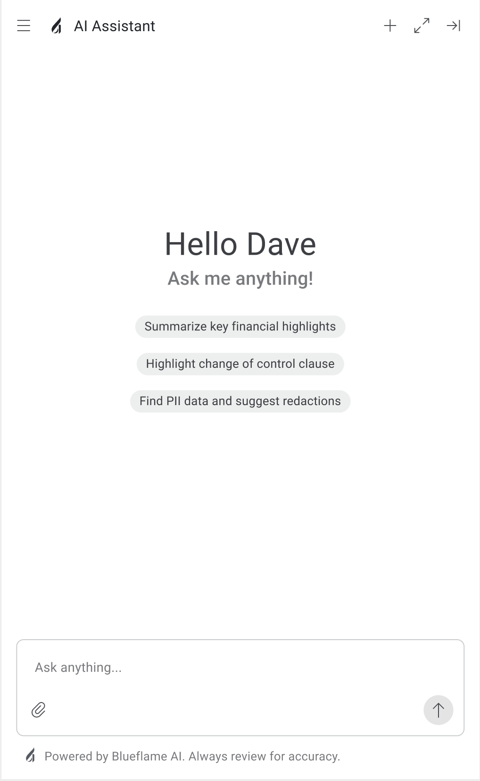
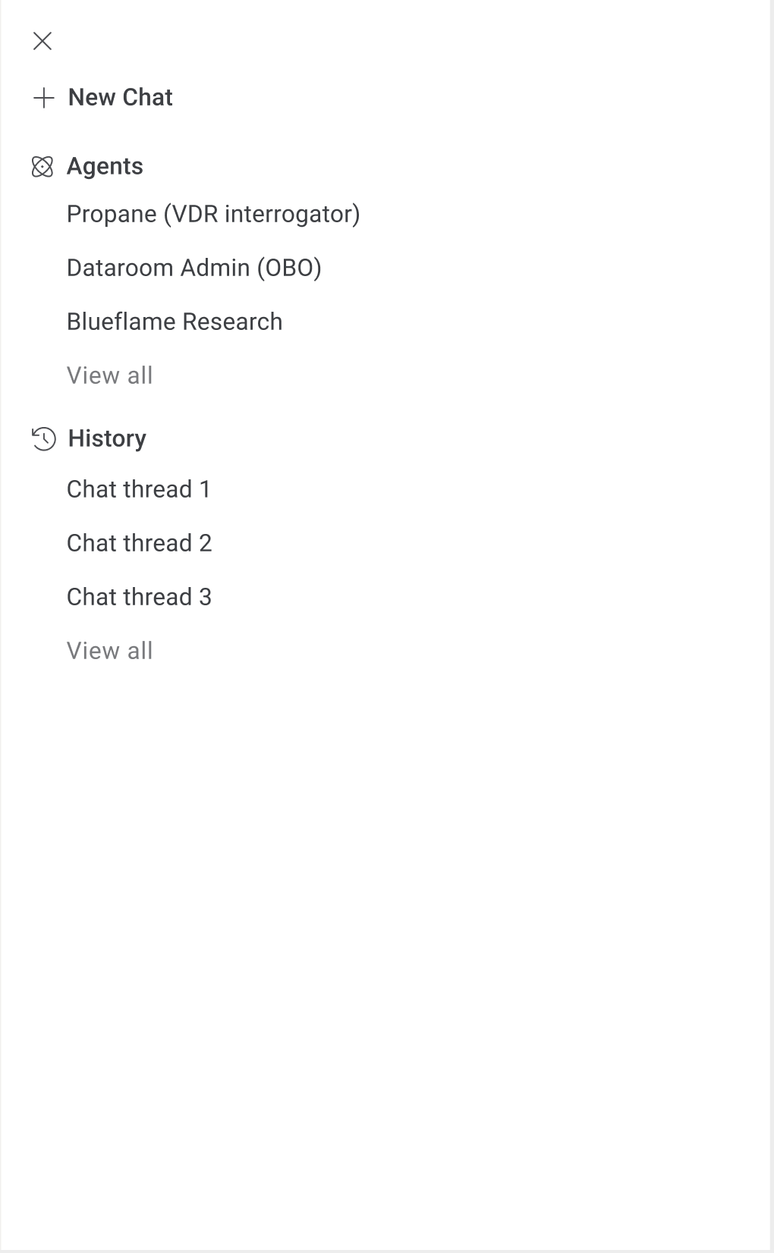
Sidecar simplification and support for future incorporation of other agents
Opens to show
Figma prototype: https://www.figma.com/design/WRC7mexcex6CEzloiJFAHU/Halo-Explore?node-id=135-11219&t=8DUmEvZdD5uCpa5a-0

